Slide 1
Modern Microservices - Continuous Delivery
2019-03-21
Notes:
As you go through the template, there are formatting tips throughout the deck, in the comments and in the slide notes so please pay attention to all the content in here. It’s all designed to help you create the best presentations possible.

Slide 3
Who am I?
Daniel Williams
dwilliams@kenzan.com
https://github.com/kenzanlabs/modernmicroservices

Slide 4
Rehashing Platform
Platform / Environment / Deployment Method
Cloud vs On-prem
Docker / Kubernetes vs VM vs Bare Metal
Isolation
Logging
Short term vs Long Term (aka Roll off)
Monitoring (Metrics and Telemetry)
Configuration Management
Credential Management
Databases / Datastores
API / Web Gateways
Deployment Managers
Documentation
Ran into major shortfalls in documentation.

Slide 5
Biggest Question: Build or Buy?
Heavily influenced by project size and budget
For open source projects: Buy Buy Buy
Usually one can find free versions (usually limited) for public / open source projects
Support infrastructure resource footprint will be as big as, usually two to three times bigger than, the application resource footprint.
People
Money
Time

Slide 6
Environments
Local
Development
Sometimes more than one
Test / Staging
Production
Defect / Fault Analysis

Slide 7
Deployment Methods
Recreate:
terminate all old
create all new
Rolling:
terminate one old
create one new
repeat until all done
Blue/Green (Red/Black):
Create all new in parallel
cut traffic over from old to new
terminate all old
Canary:
Create portion new
Cut portion traffic from old to new
Repeat until all traffic cut over
Terminate all old
A/B Testing:
Like canary, but never completes
Used for testing features/changes
Shadow:
Copy of all traffic to old goes to new
Responses from new go to /dev/null

Slide 8
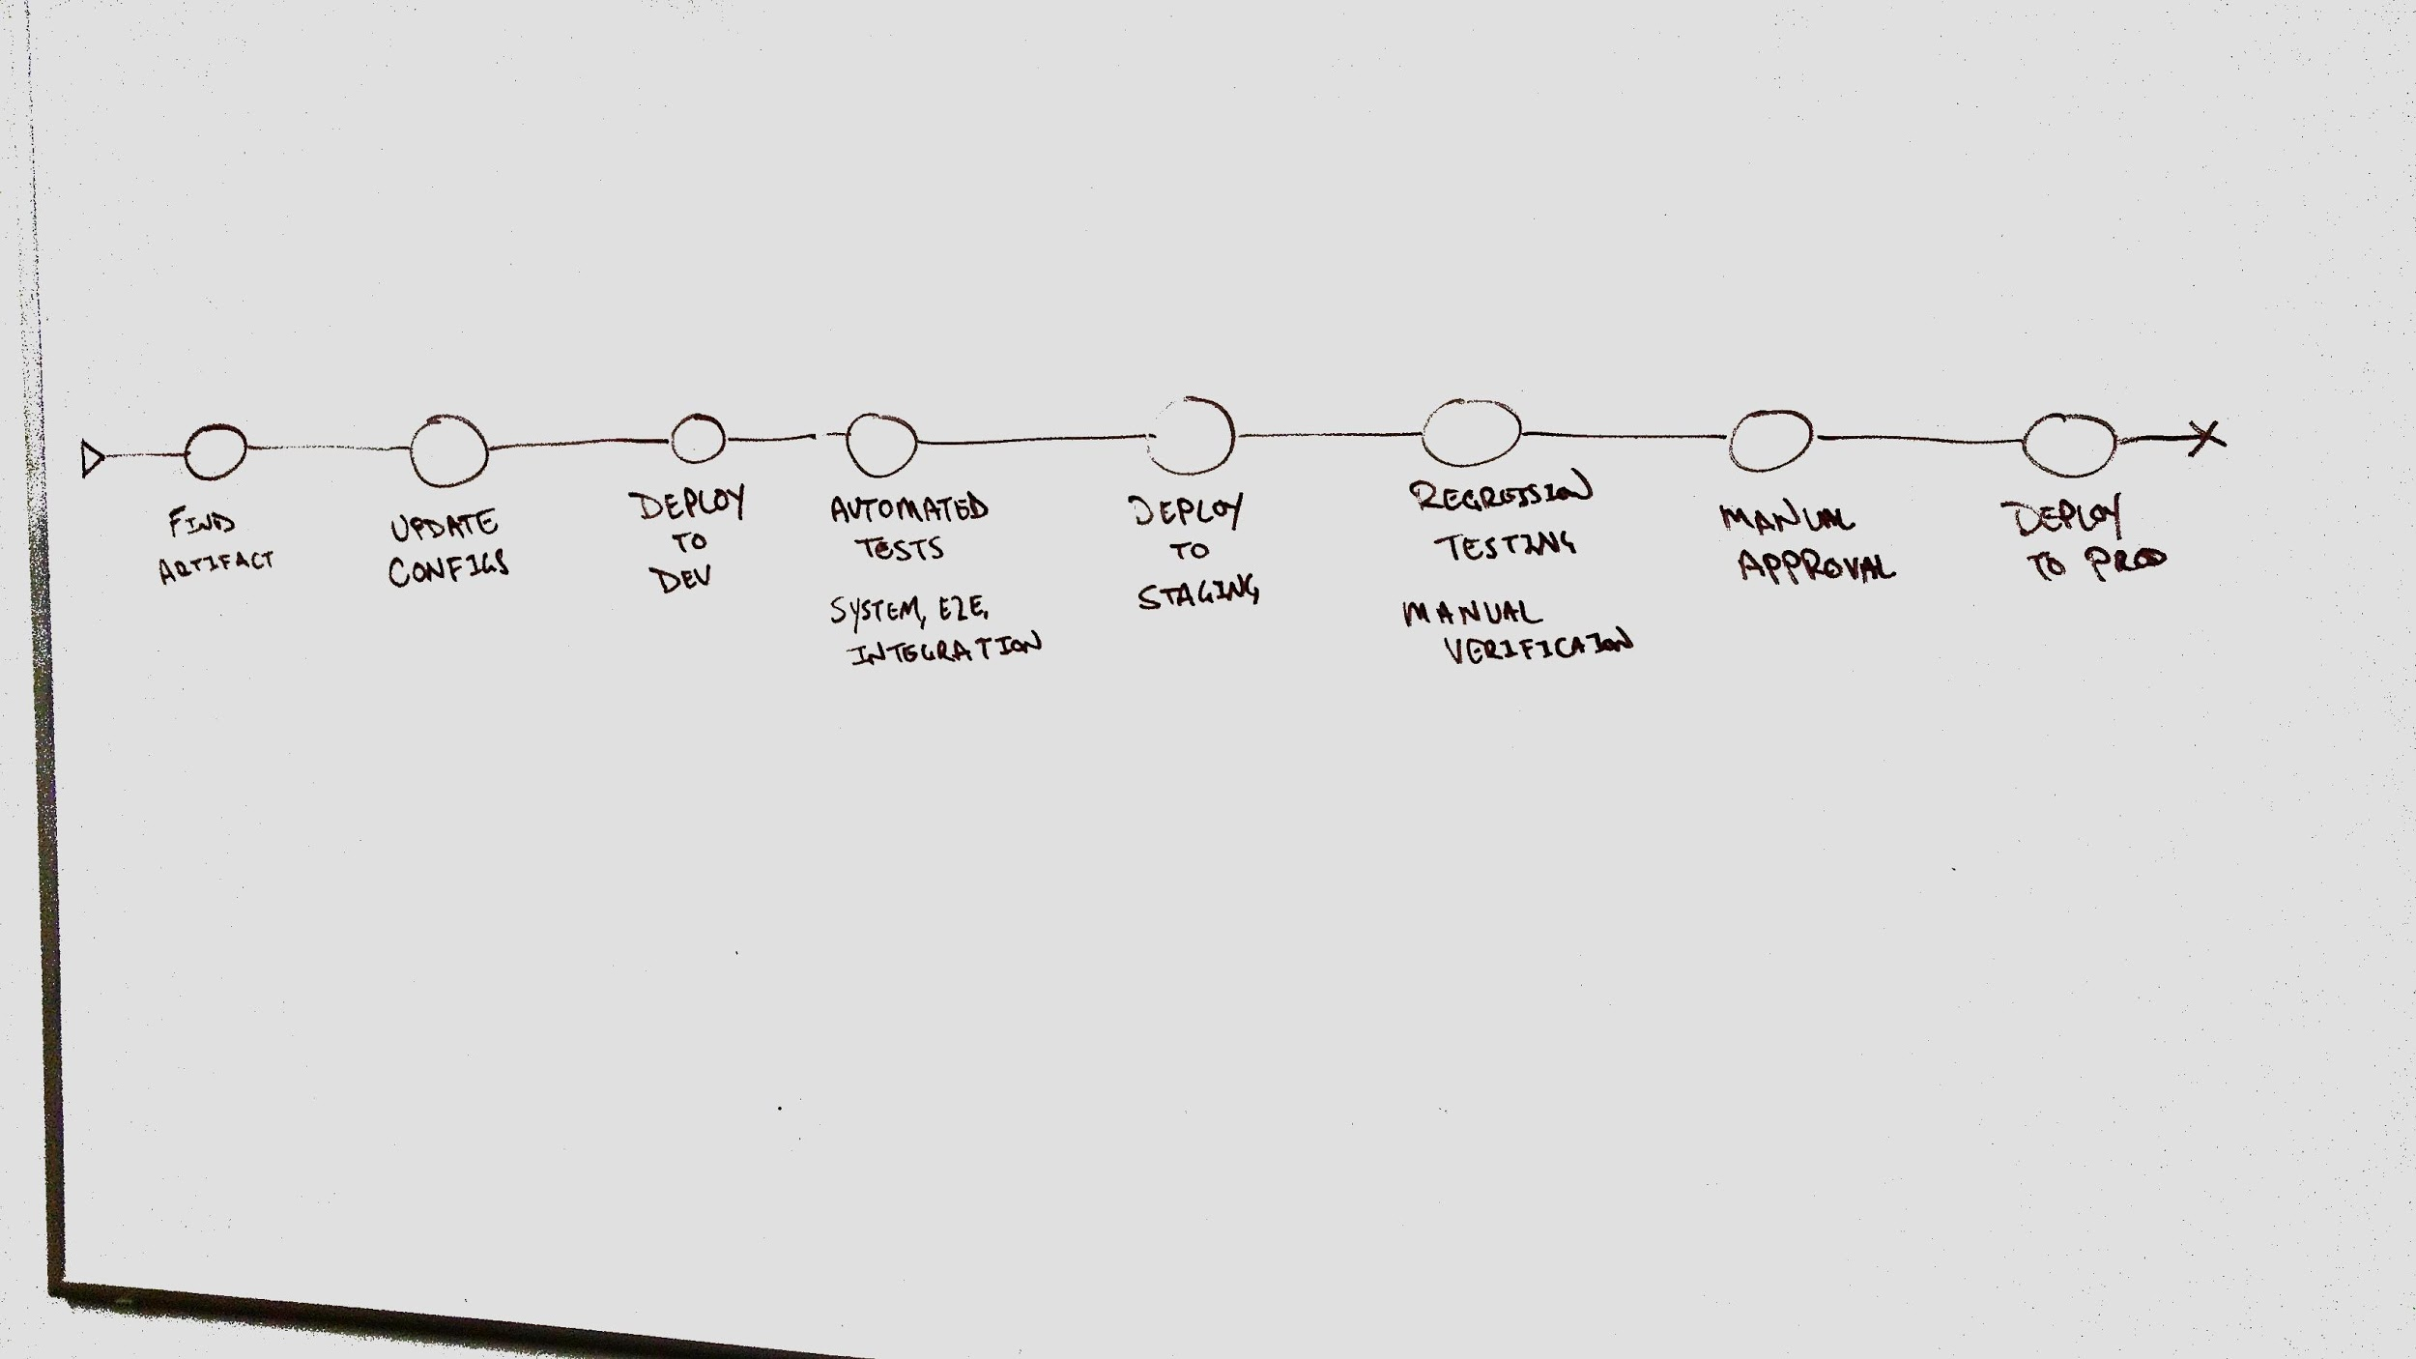
Deployment Pipelines
A deployment pipeline:

Slide 9
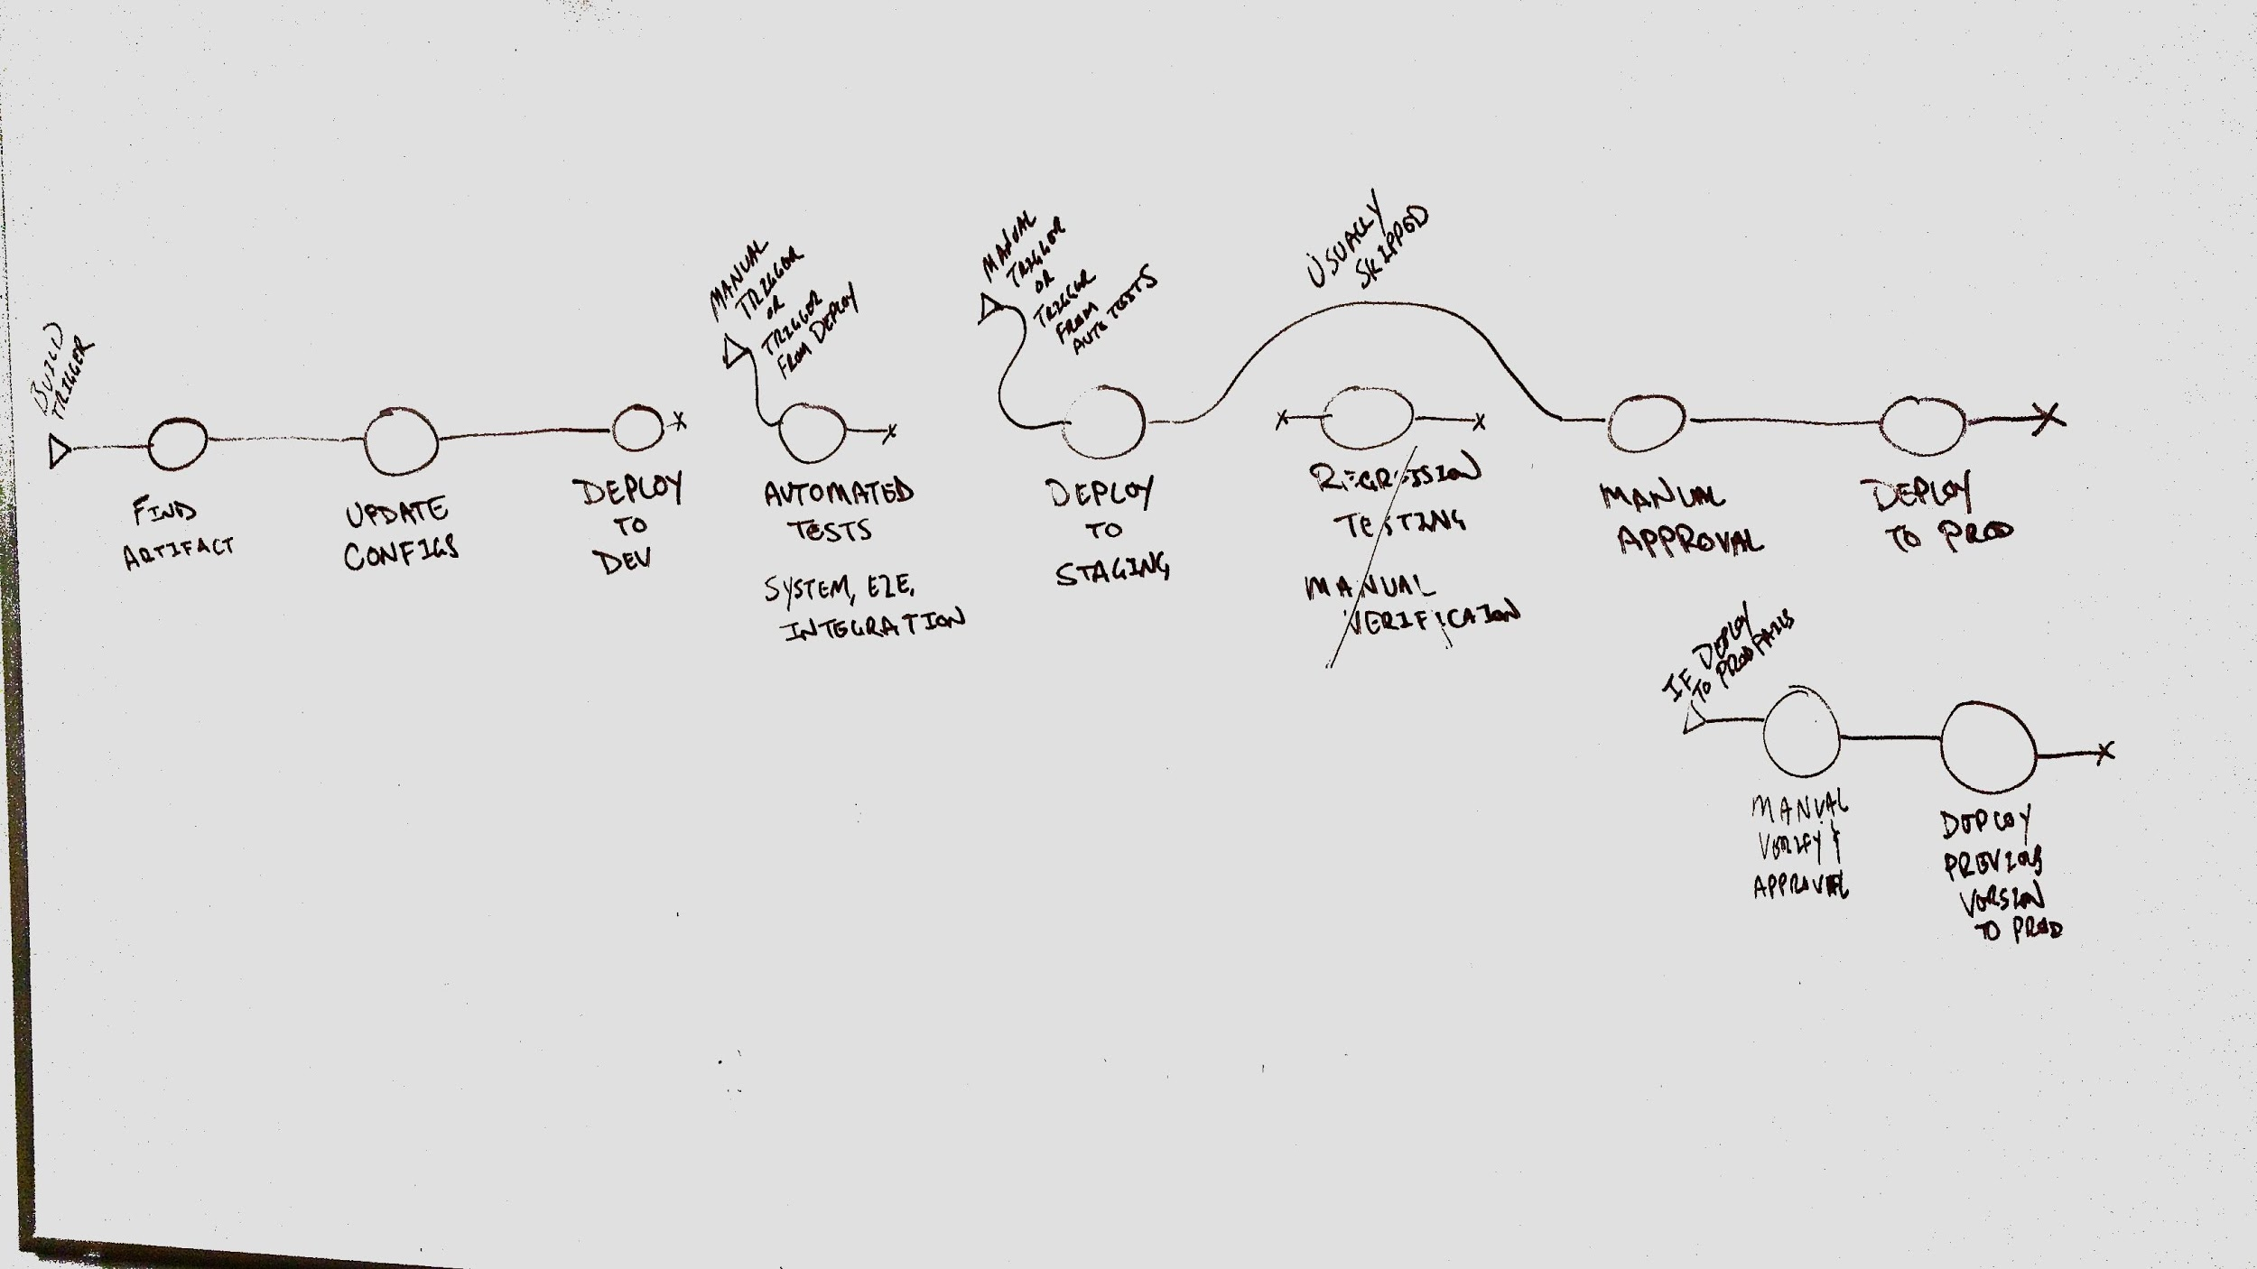
Deployment Pipelines
A (real) deployment pipeline:

Slide 10
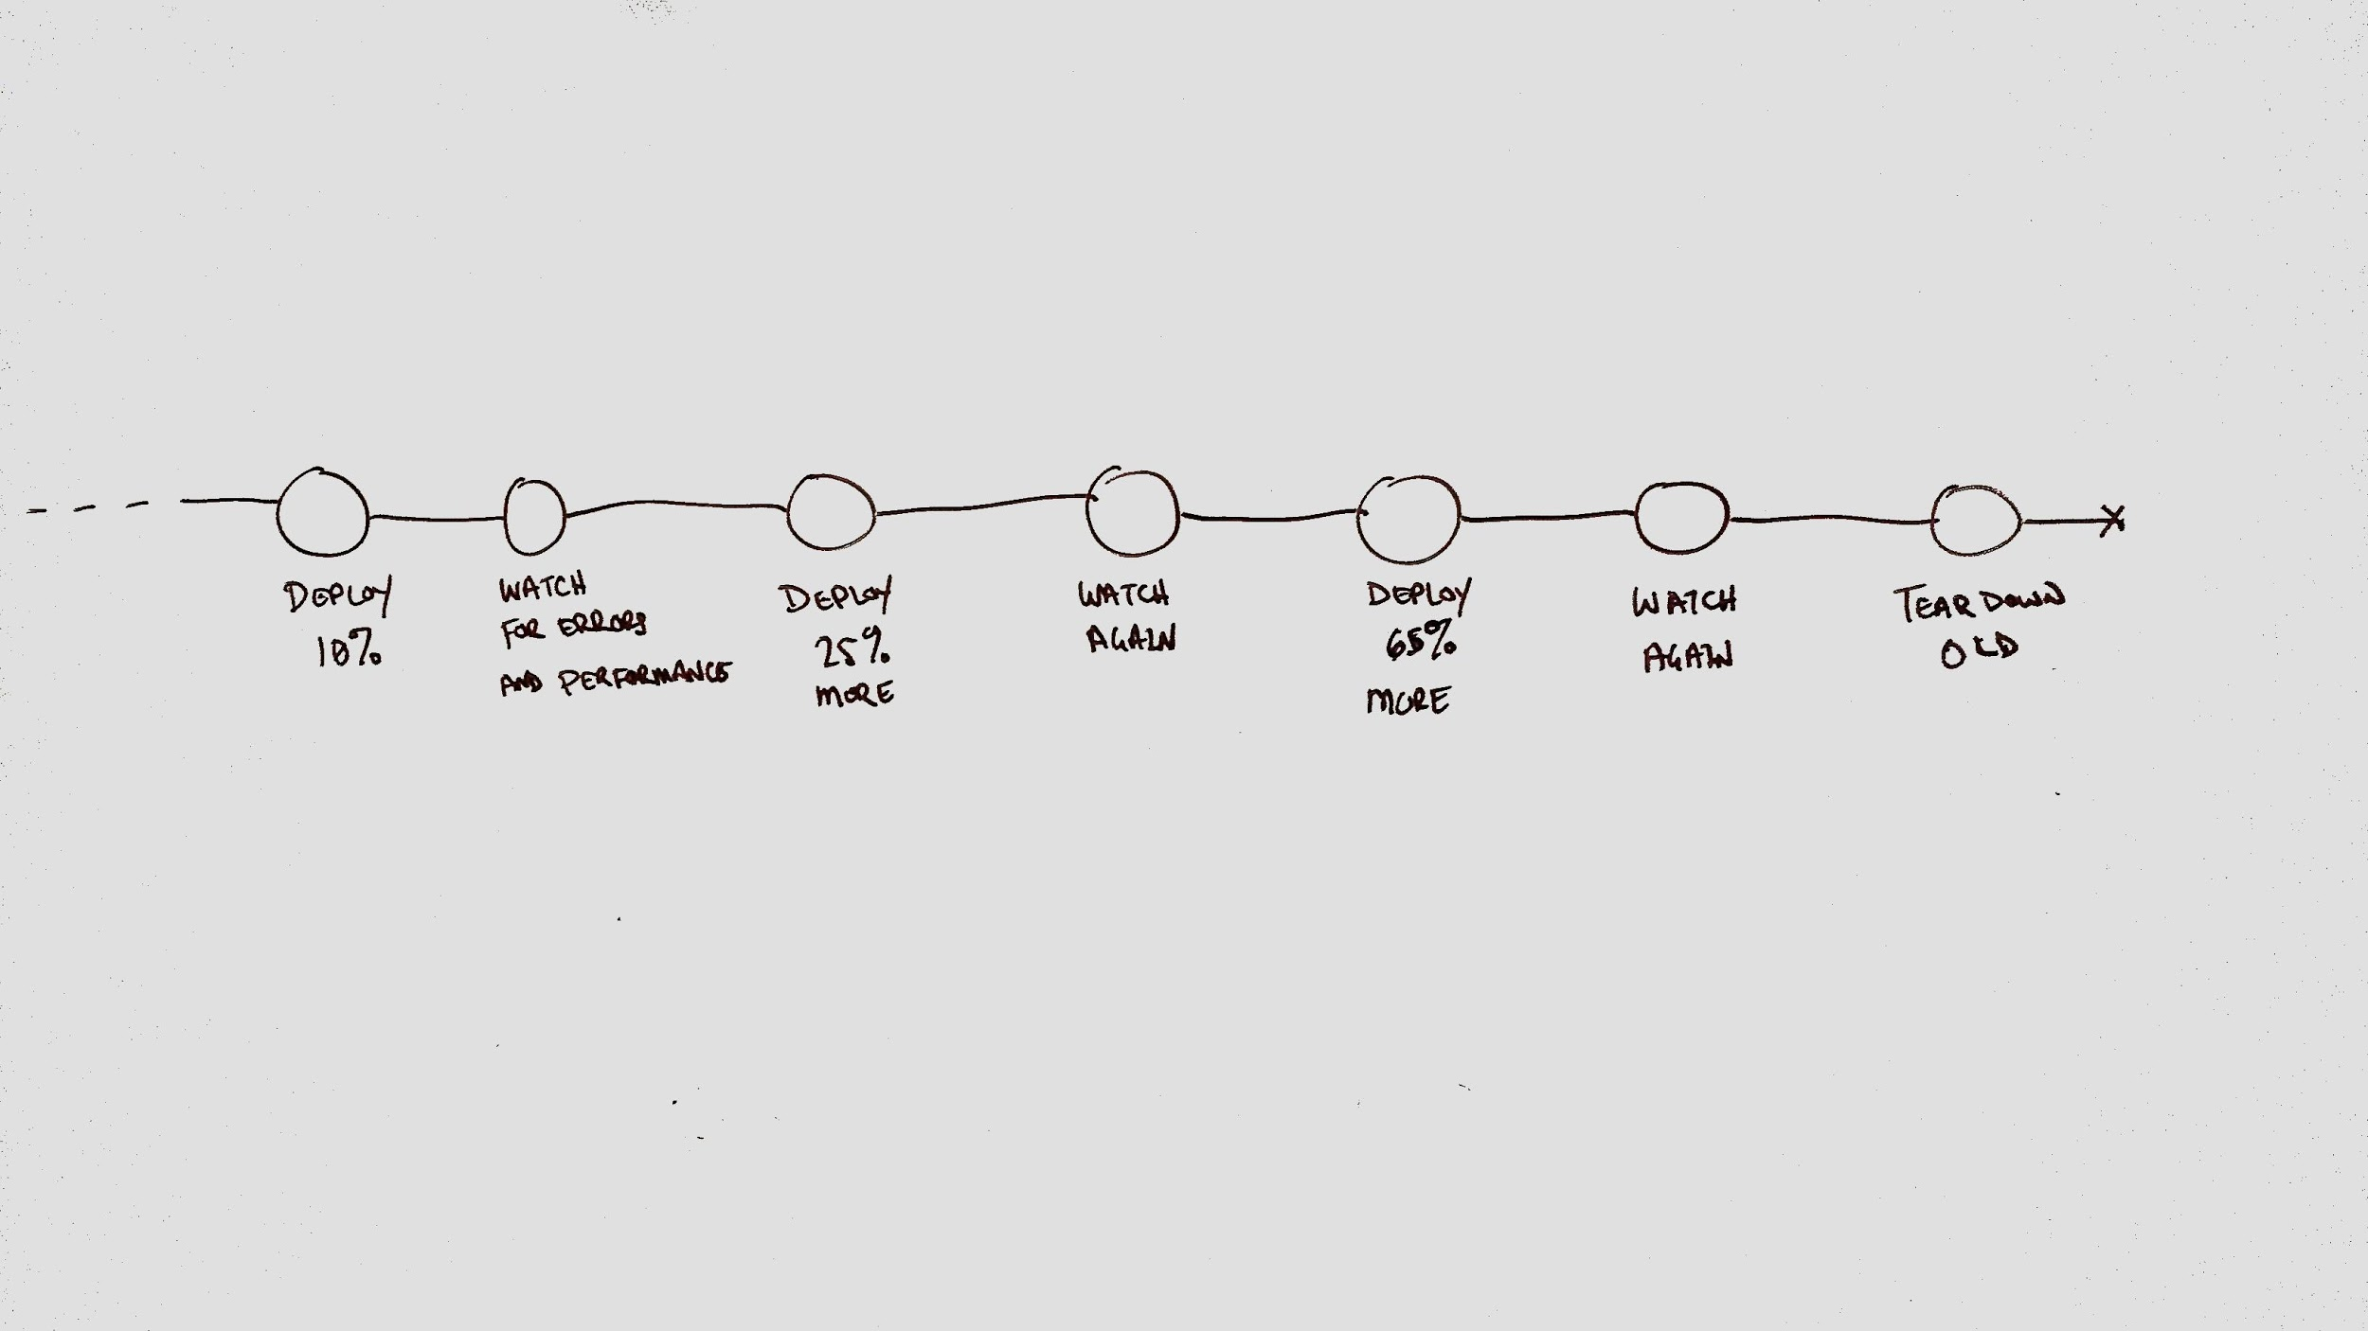
Deployment Pipelines
A canary deployment pipeline:

Slide 11




Thanks
@kenzanmedia
www.linkedin.com/company/kenzan-media
techblog.kenzan.com
www.facebook.com/kenzanmedia/

